Slide 1
GA - Project Part 1 ( Lightning Talk )
Harini Kalavala – May 30 2017

Slide 2
Project Idea 1: (Predicting CSS Sign Up )
The Problem:
Given we have customer profile data as of March 2017 , predict which customers will sign up for CSS accounts ( customer self service accounts ) by the end of May 2017. This will help channel the marketing efforts towards customers with a higher probability of signing up.
Data:
Customer profile data as of March 2017.
Customer Demographic data
Agent data
Marketing email data
Hypothesis:
Customer profile information can help predict the likelihood of a customer signing up for self service account.

Slide 3
Project Idea 2: ( Predicting which non-HVH households will become HVH )
The Problem:
Given we have household data as of Jan 2013 , predict the probability of a given non-HVH household becoming a high value household in the next 4 years.
Data:
Household data at as of Jan 2013
Demographic data
Agent data
Hypothesis:
Household and demographic information can predict the likelihood of a household becoming a high value household in a defined future timeframe.

Slide 4
Project idea 3 ( Predicting default based on the Loan DataSet - Kaggle)
The Problem:
Predict the Likelihood of default for a given customer
https://www.kaggle.com/c/mercedes-benz-greener-manufacturing
Data:
https://www.kaggle.com/c/mercedes-benz-greener-manufacturing/data
Hypothesis:
Based on customer loan data and their demographic information, we can predict the likelihood of a customer defaulting the loan.

Slide 5
Project idea 4 – Finalized project ( Predicting the subrogation potential for property claims)
The Problem:
1) Predict the likelihood of subrogation potential early ( by 7th or 10th day )in the life of a property claim ( binary classification problem )
2) Predict the subrogation recovery dollar amount ( by 7th or 10th day ) in the life of a property claim ( regression problem)
Data:
Loss characteristics of a claim as of 7th Day , 10th Day.
Will limit the data to one particular cause of loss.
Hypothesis:
The loss characteristics of a claims can help predict the likelihood of a claim having a subrogation recovery. The adjuster notes ( free form text ) by itself has valuable information to make successful predictions on the claim

Slide 6
GA - Project Part 2 ( Experiment Write-up )
Harini Kalavala – Jun 2017

Slide 7
Problem Statement:
Using Claim Loss Characteristics listed below as of the 7th or 10th day into the life of a claim , predict the likelihood of the claim having a non-zero Subrogation Recovery:
( 10 – 12 predictors and adjuster notes )
Cause of Loss
Age of Home
Number of exposure units
..
..
..
Adjuster Notes
Business Case: Early identification of subro potential is important on property claims as there is risk of evidence getting lost if there’s not an explicit effort to preserve it.
Alternative Prediction: On the same dataset , see if we can predict the actual amount of Recovery Dollars ( using regression techniques )

Slide 8
Experiment Design/Analysis
Understand what % of the claims in a given period ( Claims Created in 2015 ) have had recovery.
Understand the distribution for the time it took to identify recovery potential historically by manual adjusters/existing business rules.
Understand the distribution of the time it took for the recovery dollar to come in.
Gather loss characteristics of the claims as of two different points in time based on the earlier analysis.
Read up adjuster notes for a few sample claims to understand what information is generally available within the first few weeks of a claim.
Restrict the model to the cause of loss ( ‘Vehicle’ ). Property Losses with a Cause of Loss as Vehicle have higher likelihood of recovery ( 1 in 20 ).

Slide 9
Assumptions/Risks
A very small percentage of the property claims could have recovery potential ( ~1% ). We might have to stratify the data if we are considering all property losses.
For the purposes of this project we can limit the problem to one particular cause of loss. The cause of loss of ’Vehicle’ has a recovery rate if 1 in 20.
We might have to do a few iterations to understand if the claim loss characteristics as of Day 7 or Day 10 are good enough for a decent prediction or do we have to move to later point in time as of the life of the claim.

Slide 10
Success Criteria
Ability to identify subrogation potential by 7th or 10th ( or a later date as determined by the analysis ) with a false negative rate less than 3
Revised Success Criteria ( 07/02/2017 ):
I have expanded the modeling set to causes of losses other than ‘Vehicle’ and that leads to a very low target signal in the dataset.
New Success Criteria:
Ability to identify subrogation potential by 7th day with a false negative < 6

Slide 11
GA - Project Part 3 ( Exploratory Data Analysis)
Harini Kalavala – Jul 2017

Slide 12
DataSet Summary:
Focused on 3 key Causes of Loss as the scope of this project. Consolidated misc low volume cause of losses into other
Vehicle
Water
Fire & Removal
Gathered the predictor variables as well as concatenated adjuster notes as of Day 7 into the life of a claim.
Took all claims created in 2015 to account for any seasonality differences into while training the model.
Separated the full dataset into Training ( 70% ) and Test ( 30% ) Sets. This is done so we can get the final performance metrics against the Test set vs the training set. Retained both Recovery Amount and the Recovery Flag in the test set so I can try to fit both classification and regression models.
Training Set Count : ~36K Test Set: ~15 K

Slide 13
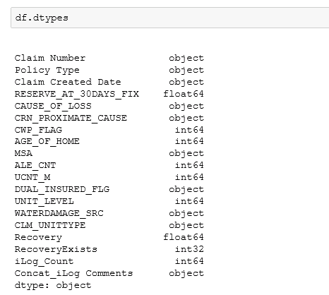
Exploratory Data Analysis: Listing Variables and it’s types

Slide 14
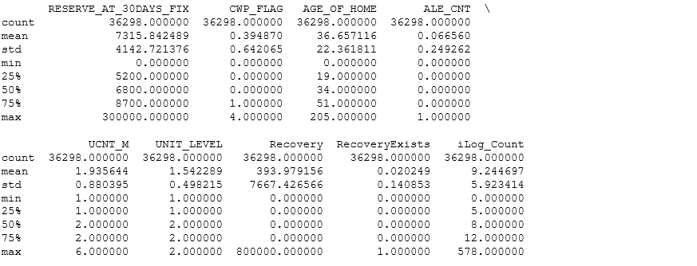
Exploratory Data Analysis: The target recovery percent is 2%. That is 2% of the claims have a recovery $.

Slide 15
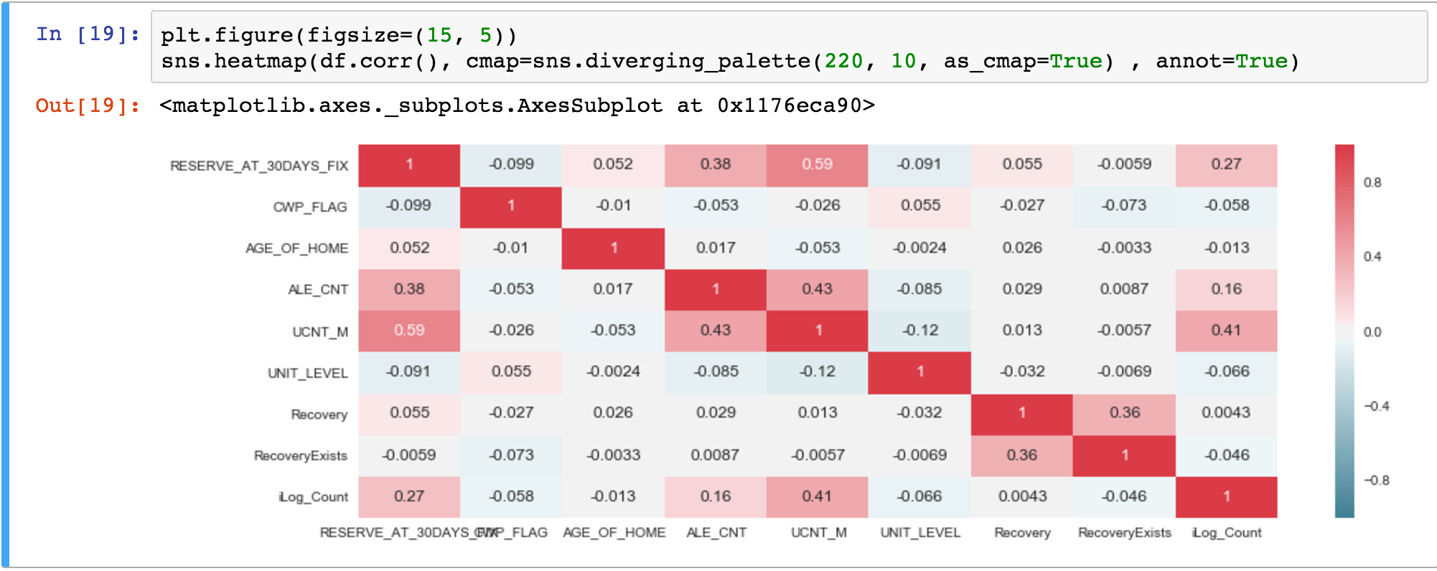
Exploratory Data Analysis: Variable Correlation Matrix ( not including the adjuster notes ) – None of the structure int data points are that correlated with the target

Slide 16
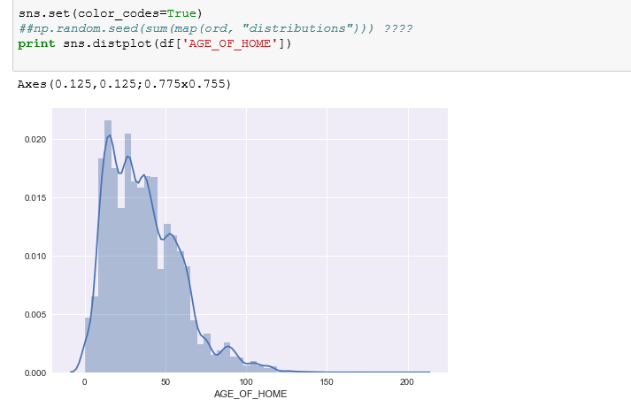
Exploratory Data Analysis: Distribution Plots for Key Continuous Variables:

Slide 17
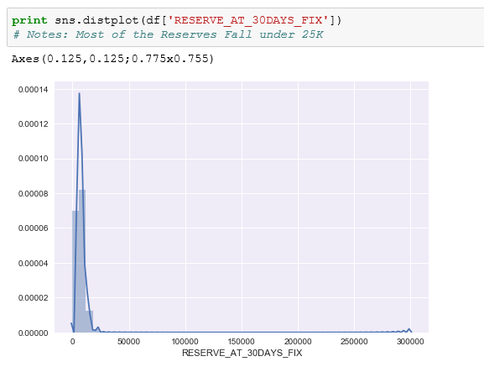
Exploratory Data Analysis: Distribution Plots for Key Continuous Variables: ( Most reserve values are less than 25K )

Slide 18
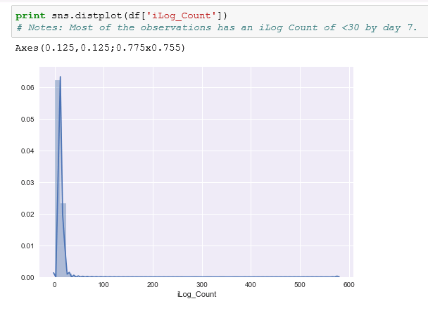
Exploratory Data Analysis: Distribution Plots for Key Continuous Variables: ( The number of ilog notes captures are less than 30 for most claims by day 7)

Slide 19
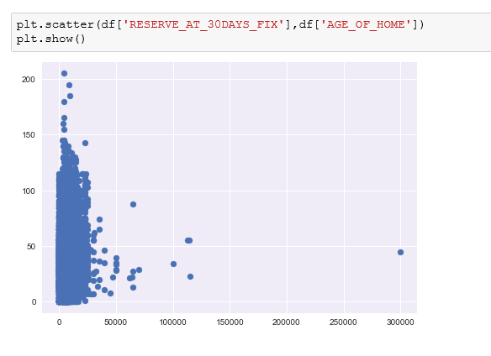
Exploratory Data Analysis: Distribution Plots for Key Continuous Variables: ( Reserve and Age Of Home Scatter Plot)

Slide 20
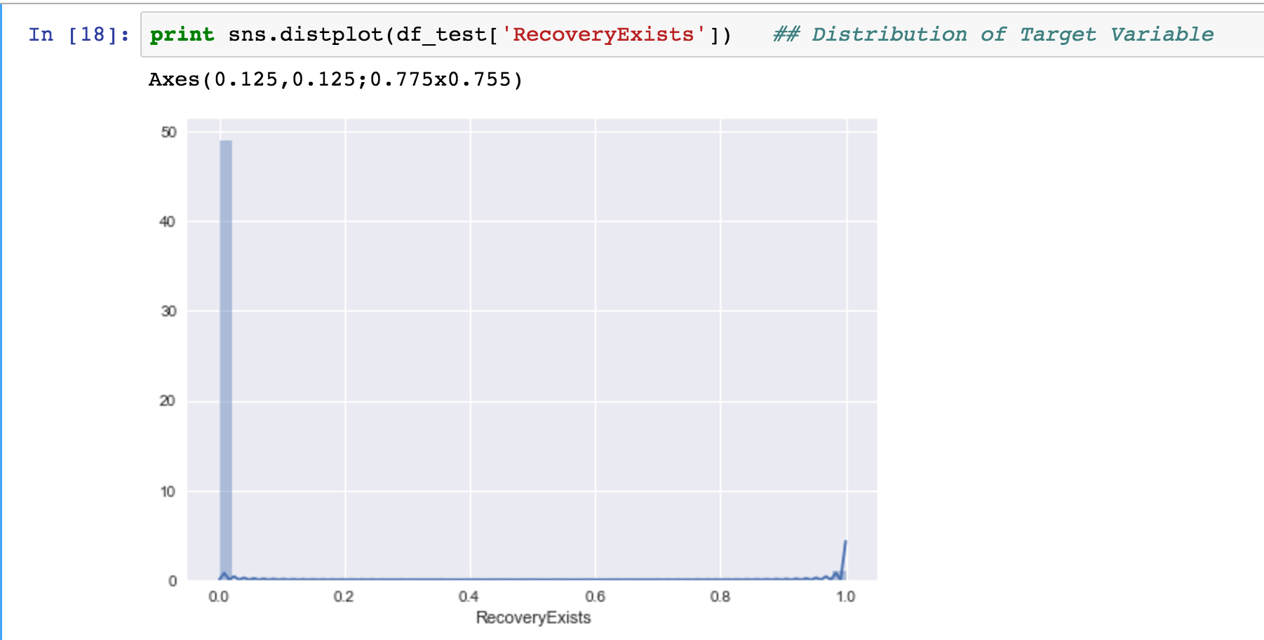
Exploratory Data Analysis: An unbalanced classification problem ( target signal is at 2 % )

Slide 21
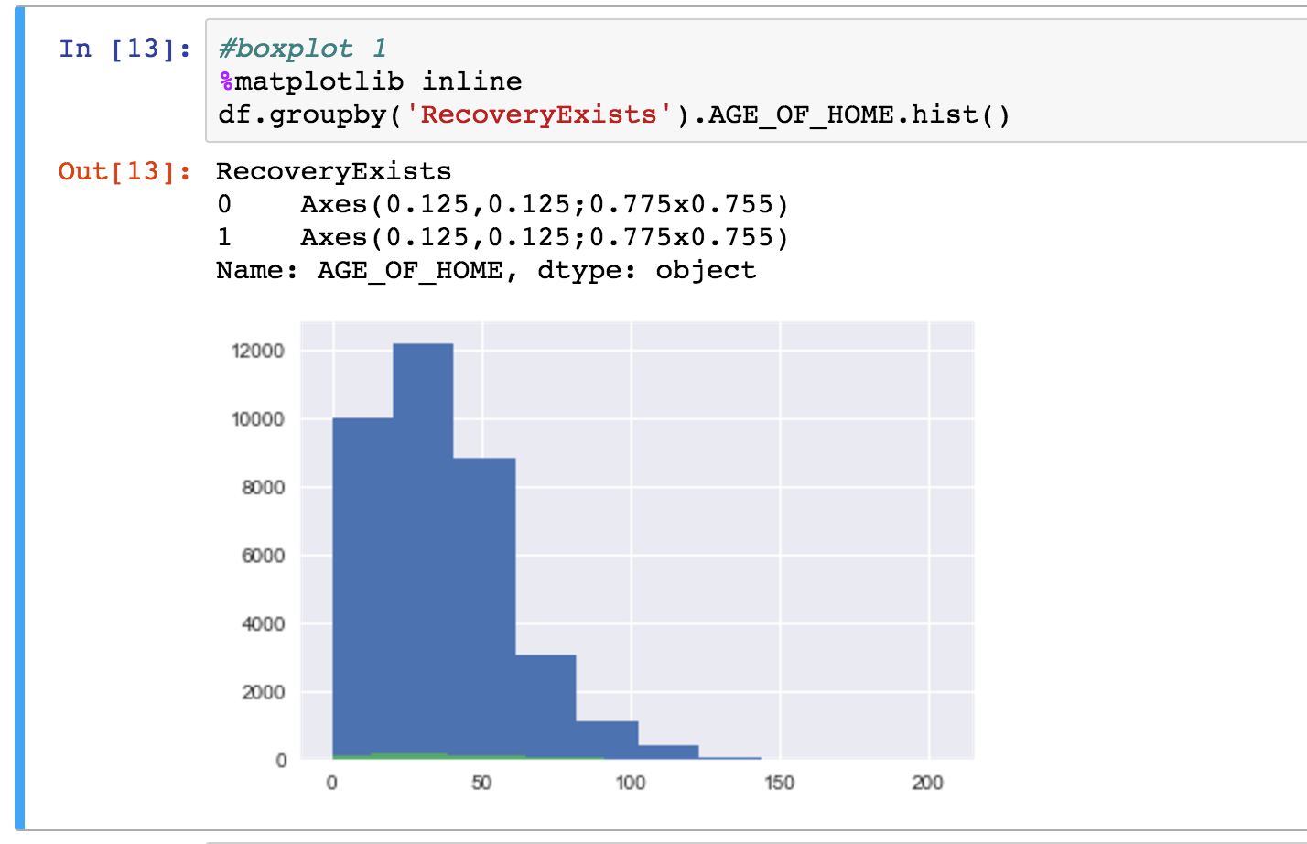
Exploratory Data Analysis: An unbalanced classification problem ( target signal is at 2 % )

Slide 22
GA - Project Part 4 ( Model Training and Evaluation)
Harini Kalavala – Jul 2017

Slide 23
Modeling Approach and Steps:
Variable Transformations / Feature Engineering:
Regrouped the cause of losses so that there are 3 primary and everything else get grouped to other. More than 90% of the records belong to these primary caused of loss.
A negligible percent of the records have null values for adjuster notes.Dropped these records
Applied basic feature engineering using get_dummies to convert categorical variables into the discrete numerical variables.
CountVectorizer didn’t appear to be of practical value.
Applied TDIF Vectorizer ( NLP ) transformation to adjuster notes.

Slide 24
Modeling Approach and Steps ( cont ):
Model Training:
67% of the dataset was used for training the model
Count Vectorizer with Decision Trees resulted in a low ”ROC-AUC” with 5 fold cross validation ( ~ 0.53 )
TDIF Vectorizer with Random Forest resulted in a little better “ROC-AUC” with 5 fold cross validation ( ~0.66 )
TDIF Vectorizer with XG Gradient Boost ( optimized with a set of parameters ) resulted in a good ”ROC-AUC” with 5 fold cross validation ( ~0.84)

Slide 25
Modeling Approach and Steps ( cont ):
Model Testing(Hold Out Set):
33% of the dataset was used for testing the final selected model
The model held up on it’s performance with an “ROC-AUC” score of ~0.84
A plot of the curve shown in next slide
Model Application (Next Steps):
Analyze the prediction outcome and the Confusion Matrix at different thresholds to derive the optimum threshold that would work for the given business problem.
Since it’s an imbalanced classifier, either down sample or up sample the dataset and see if we can get a better prediction.

Slide 26
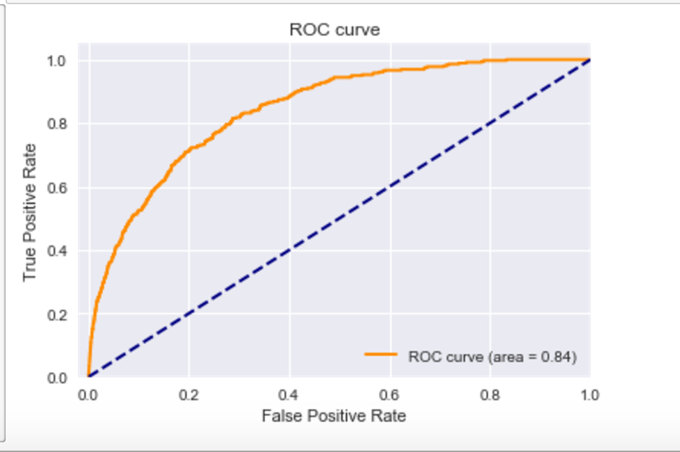
Model Test – ROC AUC Curve

